Slide 1

Department Of Computer Science And Engineering
TravelTwin – Create Personalized Travel Plans and Share Itineraries
CSA4308-Internet Programming
PRESENTED BY:
R . Danuspriyaa (192411182)
G . Devika (192371086)
E . Manisha (192372388)
SAKTHI I G (192371038)
KAVYA SRI(192311317)
GUIDED BY:
K . RAJAGOPAL

Slide 2


Introduction and Background
Travel planning has become more complex due to the availability of numerous destinations, transport options, hotels, and activities. Many travelers use multiple applications for booking, budgeting, itinerary creation, and sharing travel plans.
TravelTwin is an AI-enabled travel planning platform that combines these features into a single system. It provides personalized recommendations, itinerary management, budget tracking, and itinerary sharing with friends and the travel community.
Background
Growth of digital tourism
Increasing demand for personalized travel experiences
Need for smart itinerary planning
Importance of budget management
Social sharing of travel experiences

Slide 3
Problem Statement
Current travel planning requires users to switch between different applications for:
Destination search
Hotel booking
Budget calculation
Trip scheduling
Sharing itineraries
This leads to
Time consumption
Poor trip organization
Budget overruns
Lack of personalization
Difficulty in collaborating with travel partners

Slide 4
Motivation and Need for the Project
Motivation
Growing tourism industry
Personalized travel demand
AI-based recommendations
Easy trip management
Digital collaboration
Need
Single platform for travel planning
Automatic itinerary generation
Expense monitoring
Travel community interaction
Secure user management

Slide 5
Objectives
Develop an intelligent travel planning system.
Provide personalized destination recommendations.
Generate optimized itineraries.
Track travel expenses.
Enable itinerary sharing.
Provide analytics through an admin dashboard.
Improve overall travel experience.

Slide 6
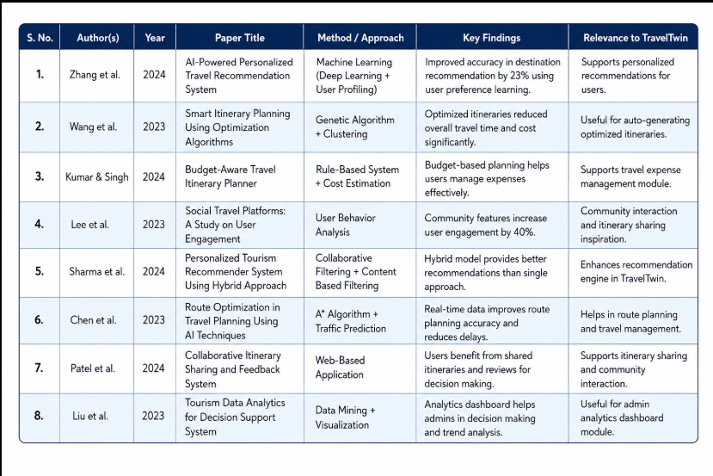
Literature Survey

Slide 7
Existing System and Limitations
Existing Systems
Google Maps
TripAdvisor
MakeMyTrip
Booking.com
Airbnb
Limitations
Separate platforms
Limited personalization
No complete budget management
Weak collaboration
Limited AI support

Slide 8
Proposed System and Novel Features
Proposed System
TravelTwin integrates travel planning, itinerary generation, budgeting, and sharing into one platform.
Novel Features
AI-powered personalized recommendations
Smart itinerary generation
Expense tracker
Community sharing
Admin analytics dashboard
Responsive web application

Slide 9
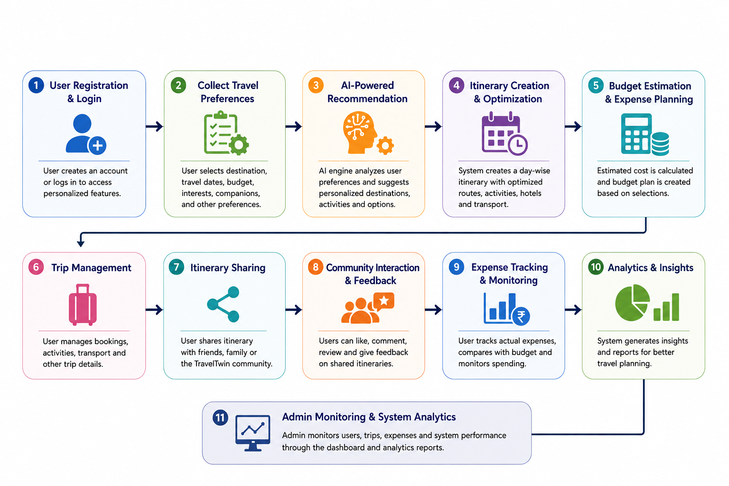
Proposed Methodology / Workflow

Slide 10
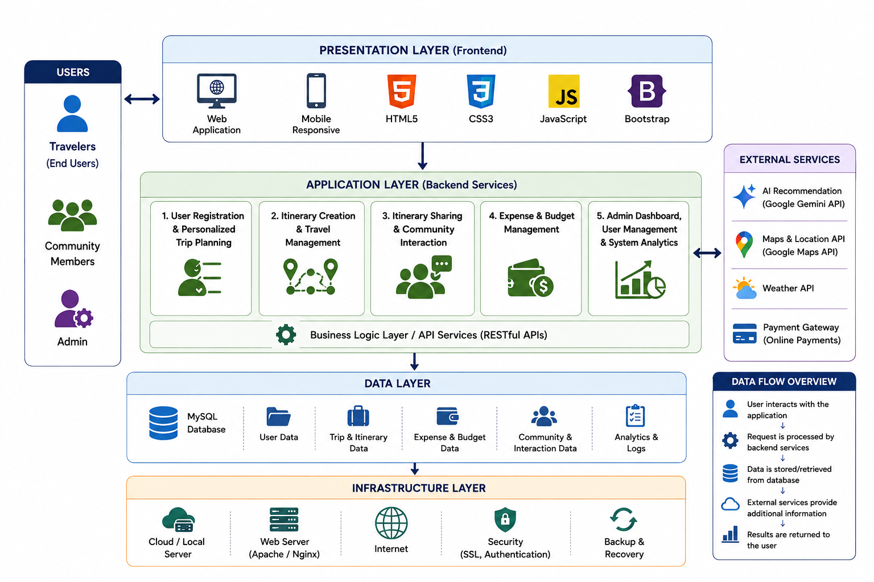
System Architecture Diagram

Slide 11
Technologies, Software, Hardware and Tools
Frontend
HTML
CSS
JavaScript
Bootstrap
Backend
Python (Flask)
Database
MySQL
AI
Google Gemini API
Tools
VS Code
GitHub
XAMPP
MySQL Workbench
Hardware
Windows PC
Intel Processor
8GB RAM
Internet Connection

Slide 12
Dataset / Data Collection
Dataset / Data Collection
Dataset Sources
Tourism websites
Google Maps APIs
Travel blogs
User preferences
Hotel information
Weather APIs
Public travel datasets
Data Collected
Destinations
Hotels
Attractions
Travel routes
User ratings
Budget details

Slide 13
Module-wise Design
Module-wise Design
Module 1: User Registration and Personalized Trip Planning Allows users to register, log in, and create profiles. Collects travel preferences to generate personalized destination and trip recommendations.
Module 2: Itinerary Creation and Travel Management Creates day-wise travel itineraries based on user preferences. Helps users manage destinations, activities, accommodations, and schedules.
Module 3: Travel Itinerary Sharing and Community Interaction Enables users to share their travel itineraries with friends and the TravelTwin community. Supports reviews, comments, and travel experience sharing.
Module 4: Travel Expense and Budget Management Tracks travel expenses and compares them with the planned budget. Provides spending summaries to help users manage trip costs efficiently.
Module 5: Admin Dashboard, User Management, and System Analytics Allows administrators to manage users, monitor system activities, and generate analytical reports. Ensures smooth operation, security, and overall system performance.

Slide 14
Current Progress and Future Work
Current Progress and Future Work
Current Progress
Literature Survey Completed
Requirement Analysis Completed
System Design Completed
Module Design Completed
Database Design Completed
Frontend Development Started
Future Work
AI chatbot assistance
Voice-based travel planning
AR/VR destination preview
Offline itinerary support
Real-time traffic prediction
Multi-language support

Slide 15
THANK YOU!
ANY QUESTIONS?

